Slide 1
Topic 2: Enhancing the stock Robo advisor
By Team 5

Slide 2
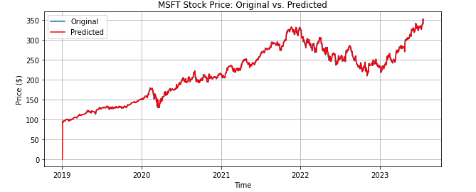
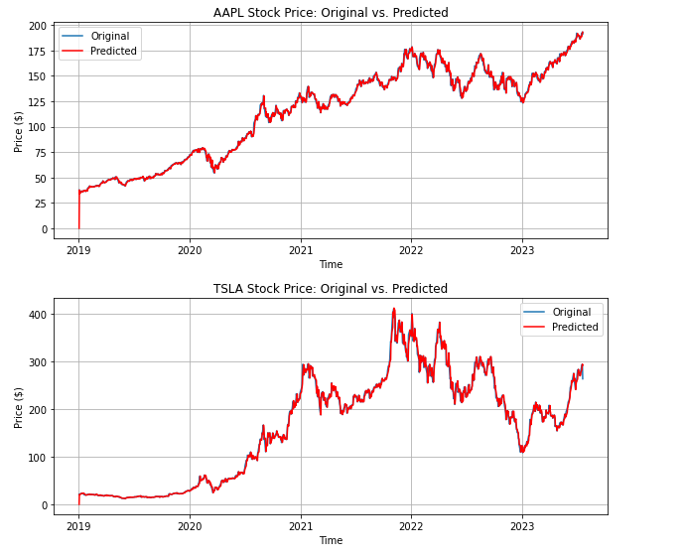
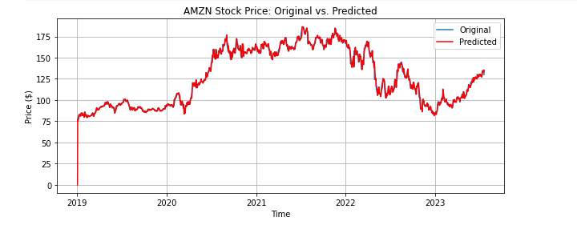
Overview of Original Model
MSTF MAPE: 0.27%
AMZN MAPE: 0.18%
AAPL MAPE: 0.15% TSLA MAPE: 0.42%
Notes:
Originally, an ARIMA model was fit to closing prices to make predictions, and plotted these predicted closing prices with the actual prices to visualize the fit. A Mean Absolute Percentage Error was also calculated for each company’s predicted closing prices to help gauge the accuracy of the model.

Slide 3
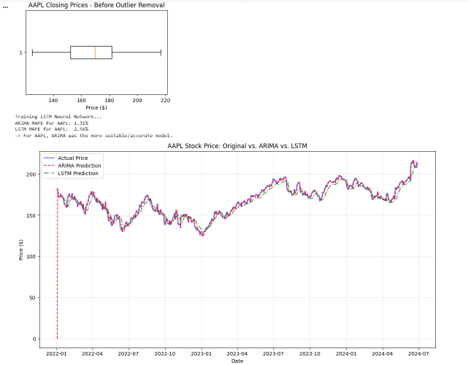
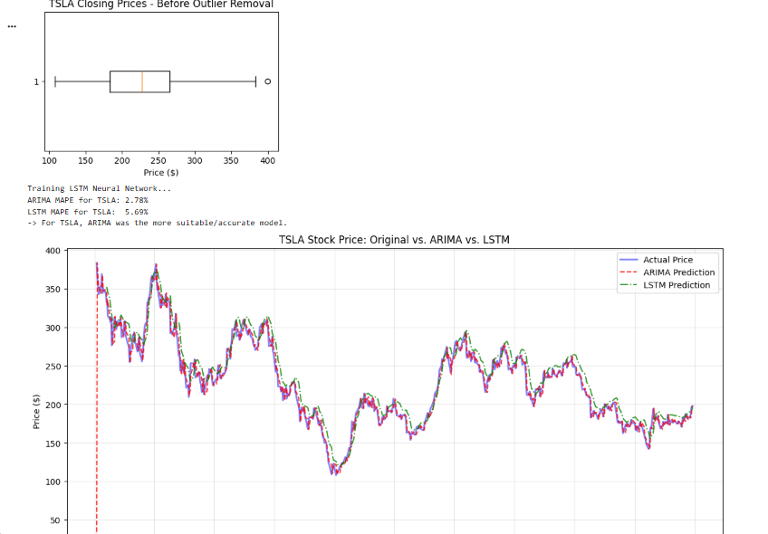
Model Enhancement
Apple Graphs:
Tesla Graphs:
ARIMA MAPE: 1.31% LSTM MAPE: 2.56%
ARIMA MAPE: 2.78% LSTM MAPE: 5.69%

Slide 4
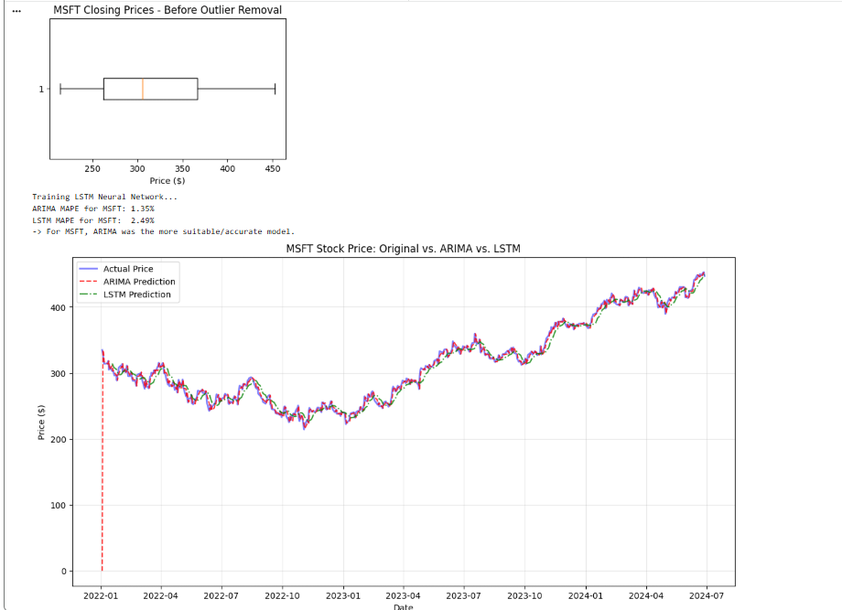
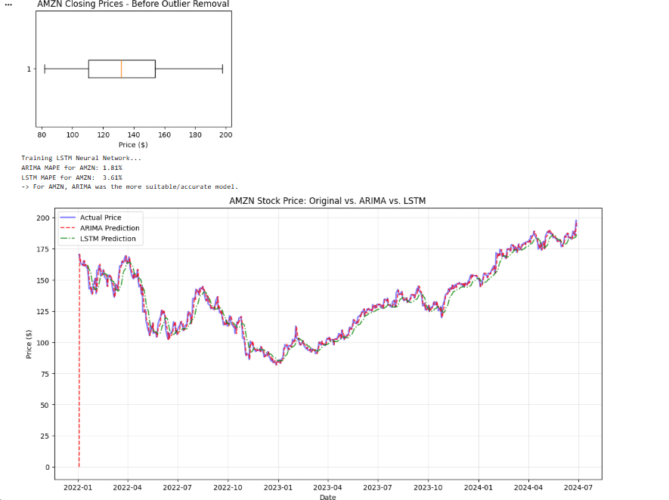
Model Enhancement
Microsoft Graphs:
Amazon Graphs:
ARIMA MAPE 1.35% LSTM MAPE: 2.49%
ARIMA MAPE: 1.81% LSTM MAPE: 3.61%

Slide 5
Model Enhancement
Outlier Handling (Box Plot / IQR Method)
Use the Interquartile Range (IQR) method to detect outliers.
Calculate:
Q1 = 25th percentile
Q3 = 75th percentile
IQR = Q3 − Q1
Define outlier limits:
Lower Limit = Q1 − 1.5 × IQR
Upper Limit = Q3 + 1.5 × IQR
Remove or cap values outside these limits before training the model.
Why this helps:
Reduces the effect of extreme price spikes.
Produces cleaner and more reliable training data.
Improves model accuracy and stability.
Prevents the model from overfitting to unusual market events.
Why does the “Enhanced” model have a higher MAPE?
Enhanced model was between 2022-2024, but the original model was based on 2019-2023
2019-2021 had a relatively smooth trend, so it made it easy for the ARIMA model to predict
2022-2024 included massive tech crashes and subsequent volatile recovery.
Outliers were also different because the IQR were different
Different values were flagged as outliers which may help support the MAPE in the original model

Slide 6
Model Enhancement
Prediction Model Comparison
ARIMA(5,1,0):
Suitable for short-term forecasting.
Works well with linear time-series data.
Simple, fast, and easy to interpret.
Neural Networks (LSTM):
Captures complex and non-linear patterns in stock prices.
Can model long-term dependencies better than ARIMA. (ARIMA was more effective in all the models however).
Requires more data and computational resources.
Most Suitable in theory (LSTM):
Reasoning: Since stock prices often exhibit complex and non-linear patterns, an LSTM model is generally the most suitable for achieving higher prediction accuracy, while ARIMA serves as a strong baseline for comparison, but in the model, it was ARIMA that had the lowest MAPE.
This is because I set epochs (iterations) = 10 for LSTM. I changed it to 200, and the MAPE instantly dropped from 2.56% to 1.33% for AAPL, but that took a few minutes to calculate.

Slide 7
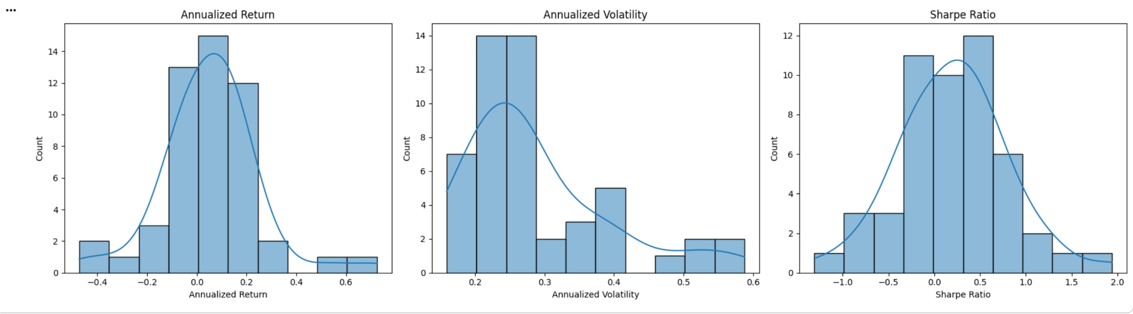
Findings from the data exploration part
Calculated Annualized Return, Annualized Volatility, and Sharpe Ratio
Most stocks had moderate annualized returns, while a few had exceptionally high or low returns.
Annualized Volatility was concentrated at lower values, with several higher-risk outliers.
Sharpe Ratio showed that only a small number of stocks achieved high risk-adjusted performance

Slide 8
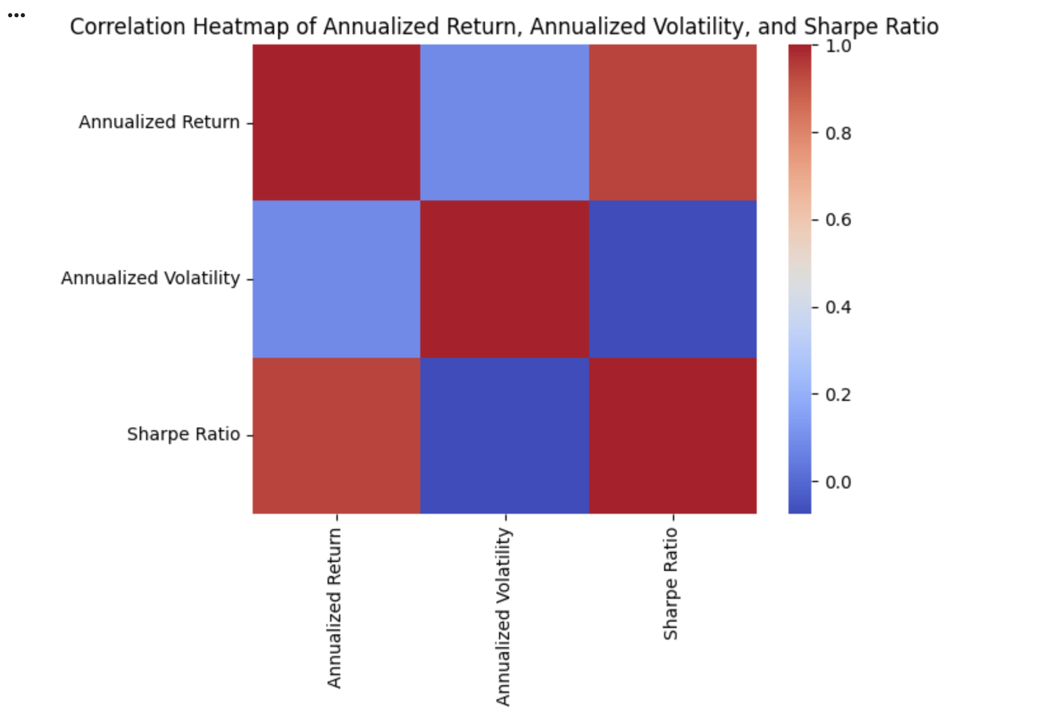
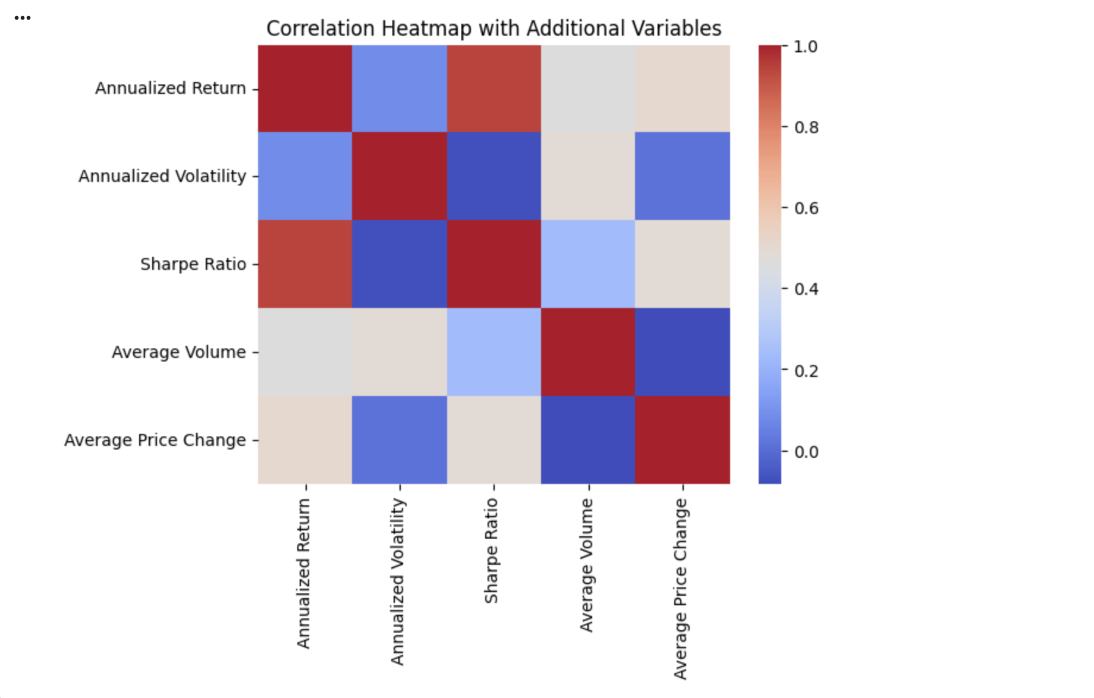
Findings from the data exploration part
Annualized Return is strongly positively correlated with the Sharpe Ratio
Annualized Volatility is weakly negatively correlated with the Sharpe Ratio
Average Price Change is moderately positively correlated with Return and Sharpe Ratio
Average Volume has weak correlations with the other metrics
Higher annual returns generally lead to higher risk-adjusted performance (Sharpe Ratio)
Higher volatility tends to slightly reduce risk-adjusted returns, but the relationship is weak
Larger daily price movements are generally associated with higher returns and better risk-adjusted performance
Trading volume has little impact

Slide 9
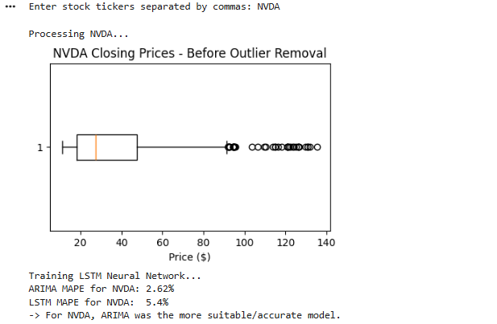
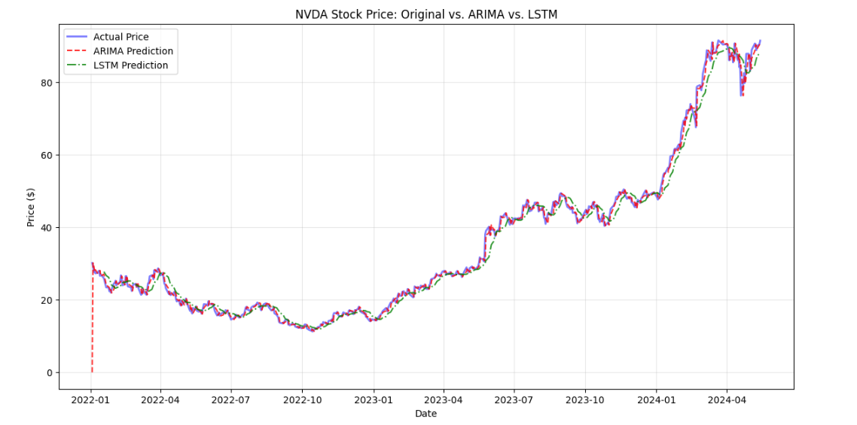
Feedback on the Model
Feedback System:
Model gives user recommendations to buy, hold, or sell based on the tickers inputted
User then agrees or disagrees with each recommendation
How to improve the model based on the feedback:
Model relies on past data
If a company comes out with a revolutionary product, our model cannot take this into account
Jumps from Federal Reserve adjusting interest rates or 2-for-1 stock splits
Feedback can help account for these dramatic spikes, as the model relies on prices and not number of stocks

Slide 10
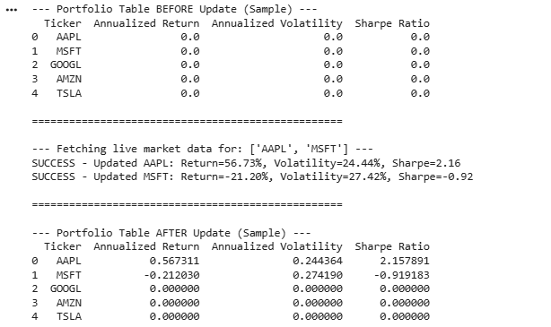
Future Enhancements
Real time update feature (part 4)
Winsorization
Allows us to refrain from deleting lots of rows
No skewing but data not removed
Risk tolerance quiz
3 question quiz
Filter clusters
Notes:
In part 4 of the project I chose to implement real-time update feature that dynamically adjusts recommendations based on the latest data. This basically made the machine learning model cluster, predict, and and make recommendation based todays actual price history, while otherwise our model would be going off of past history. A future enhancement we can make is outlier winsorization. During the model enhancement (part two) we had to handle lots of outliers using the interquartile method therefore deleting the rows. With winsorization we don't have to delete the outliers, we just have to cap them at a certain specific limit. This capping keeps the stocks in our database, but tames the extreme values so they don't skew our model. We can also add a risk tolerance quiz, asking the user what their risk tolerance is. We can use this quiz to filter what cluster of stocks we show the user. This will help match recommendation, to a user.

Slide 11
Questions?
Thank you!

